Slide 1
Case Study 2
Analyzing Data from MovieLens: The Business Case for Studying Poorly Rated Movies
Group 1: Claire Danaher, Jonny Friedman, Janvi Kothari, Renee Sweeney, Erin Teeple
October 26, 2017

Slide 2

MovieLens
A research site maintained by GroupLens Research at the University of Minnesota.
Users enter movie ratings and can assign tags.
MoveiLens data can be used to generate personalized movie predictions and ratings data is available for research use.
REF: https://movielens.org/info/about

Slide 3
1M Ratings MovieLens Data Set Items
Information Fields:
User ID
Movie ID
Rating
Timestamp
Title
Genre
Gender
Age
Occupation
Zip code

Slide 4
Case Objectives
Analyze ratings data
Make conjectures and evaluate them to achieve a narrative interpretation
Propose a business case application for movie ratings data analysis

Slide 5
Basic Analysis
Initial Details
Overall average over 4.5: 29 movies
Among all men: 20 movies
Among all women: 70 movies
Median rating over 4.5
Among men over 30: 105
Among women over 30: 187
Not many movies are highly rated on average.
Do these findings mean women overall are an easier to please audience than men?

Slide 6
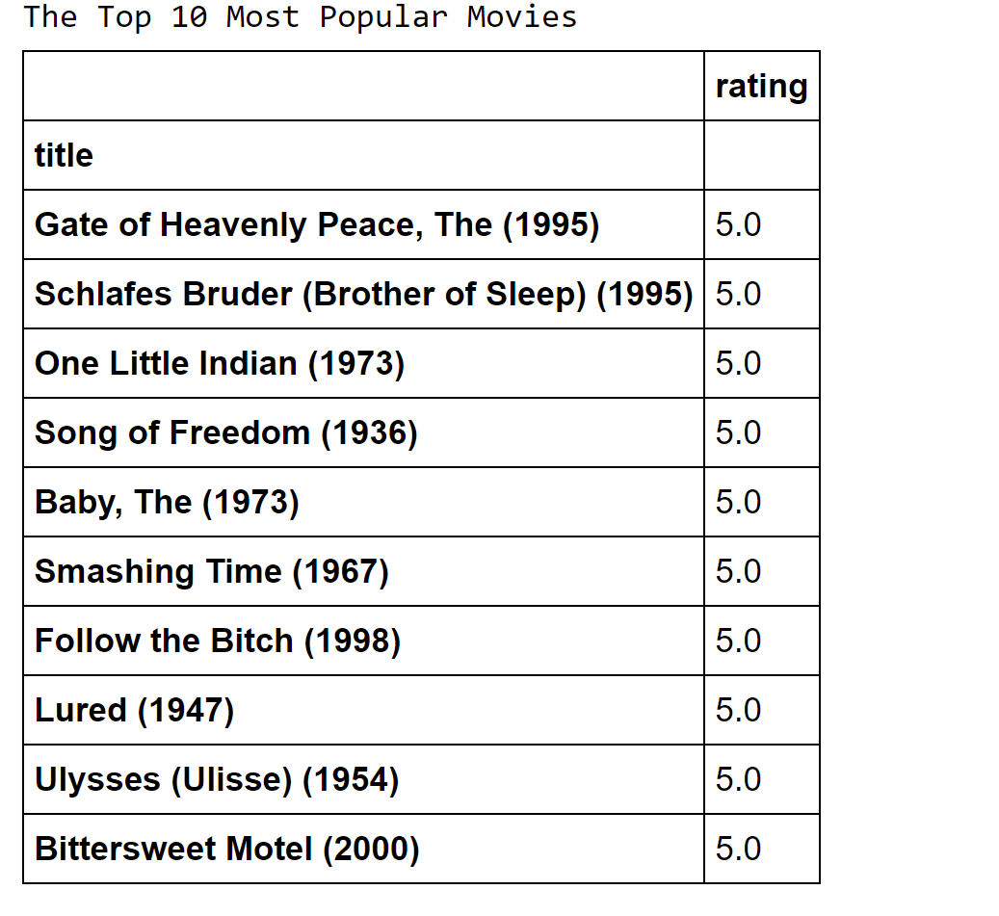
Further Analysis
10 most popular movies
“Popular”
Widely viewed
Rating frequency above median
Highly rated
Highest rated movies among widely viewed movies.
Poorly reviewed movies
“Most poorly rated movies”
Widely viewed
Rating frequency above median
Poorly rated
Lowest 5% of scores
Has anyone in this class watched any of these “popular movies?

Slide 7
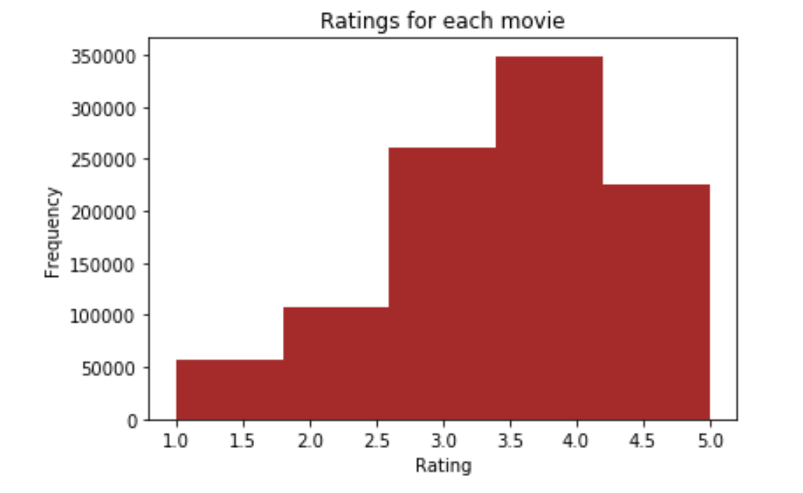
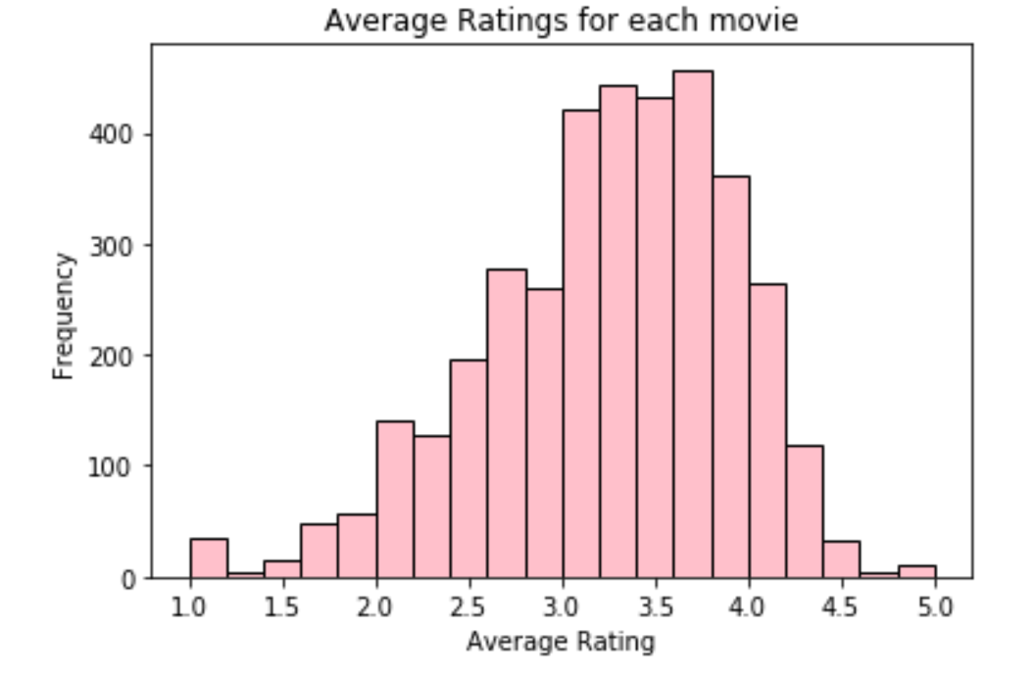
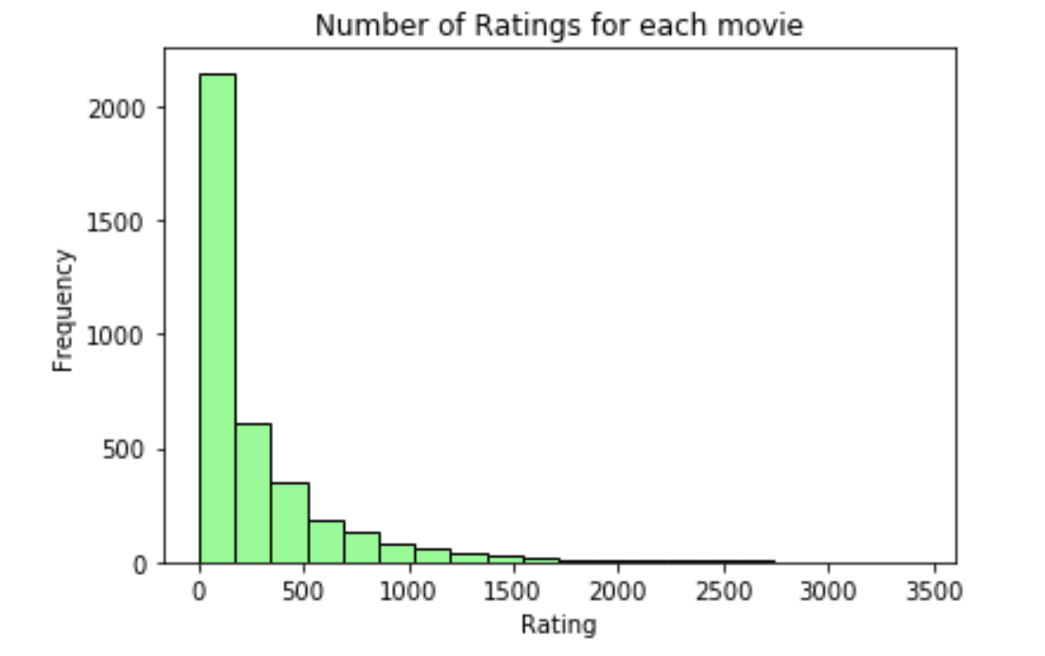
Histograms
Most Frequent and Average Movie ratings centered between 3 and 4
Some movies are much more frequently rated than others...

Slide 8
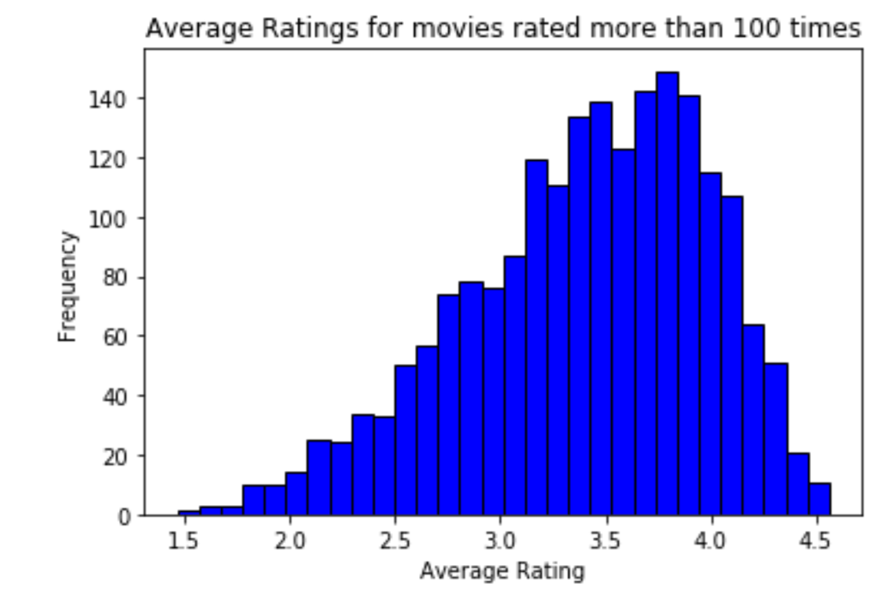
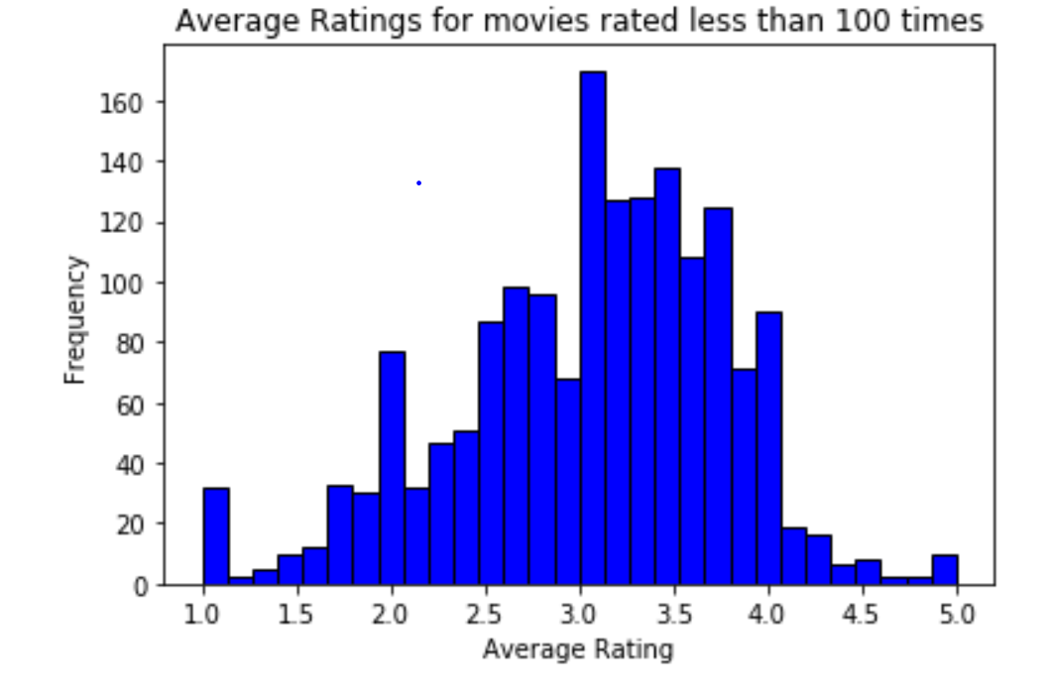
Histograms by Number of Ratings
Distribution for movies rated more than 100 times is slightly left skewed but roughly normal-appearing
Distribution for movies rated less than 100 time appears less normal.

Slide 9
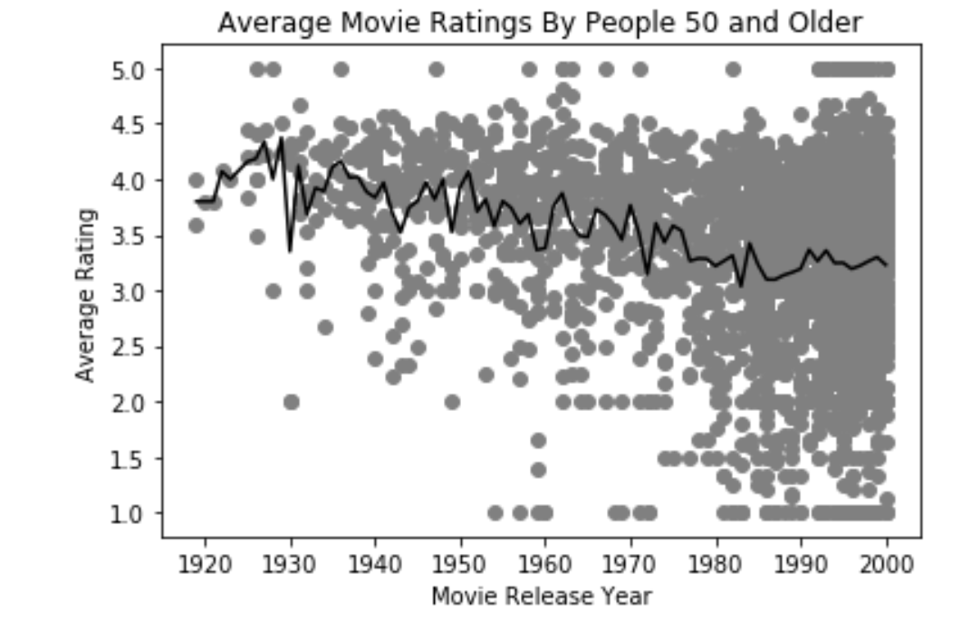
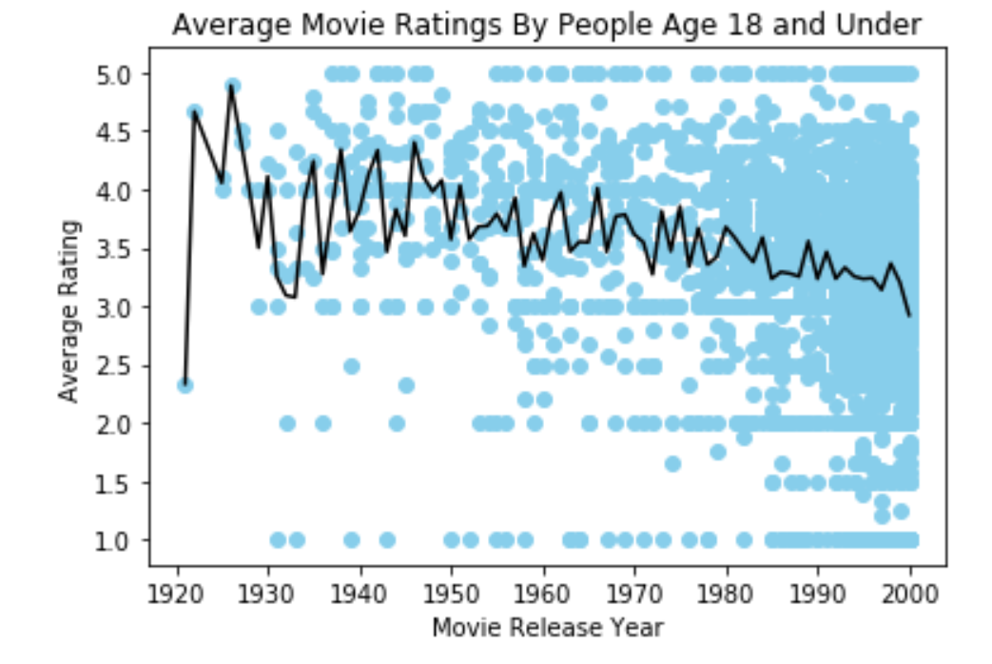
Conjectures 1: Average Movie Ratings by Movie Year and Rater Age
Viewers over age 50 rate older movies slightly more highly on average.
Viewers under age 18 do not show a similar trend in average preference for more recent movies compared with older movies.

Slide 10
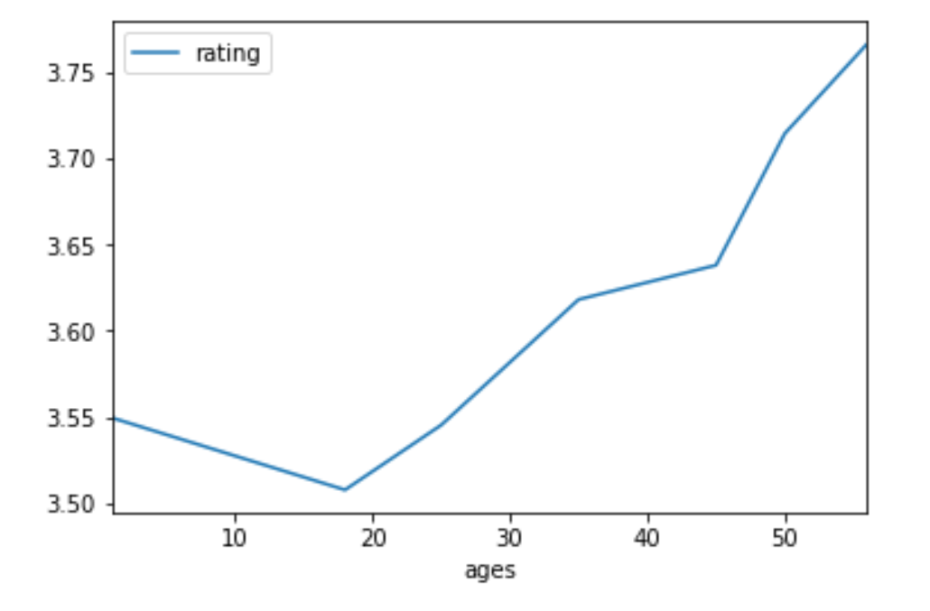
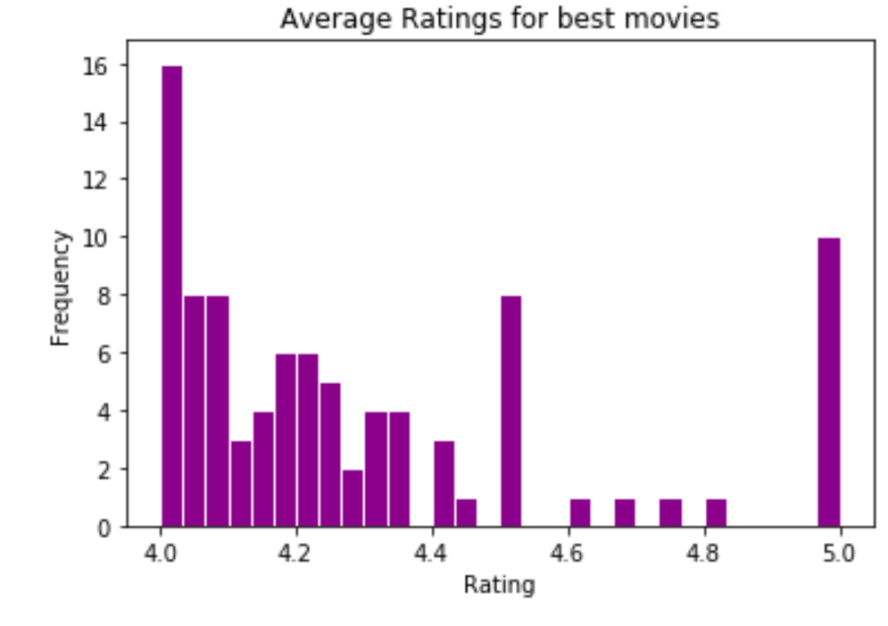
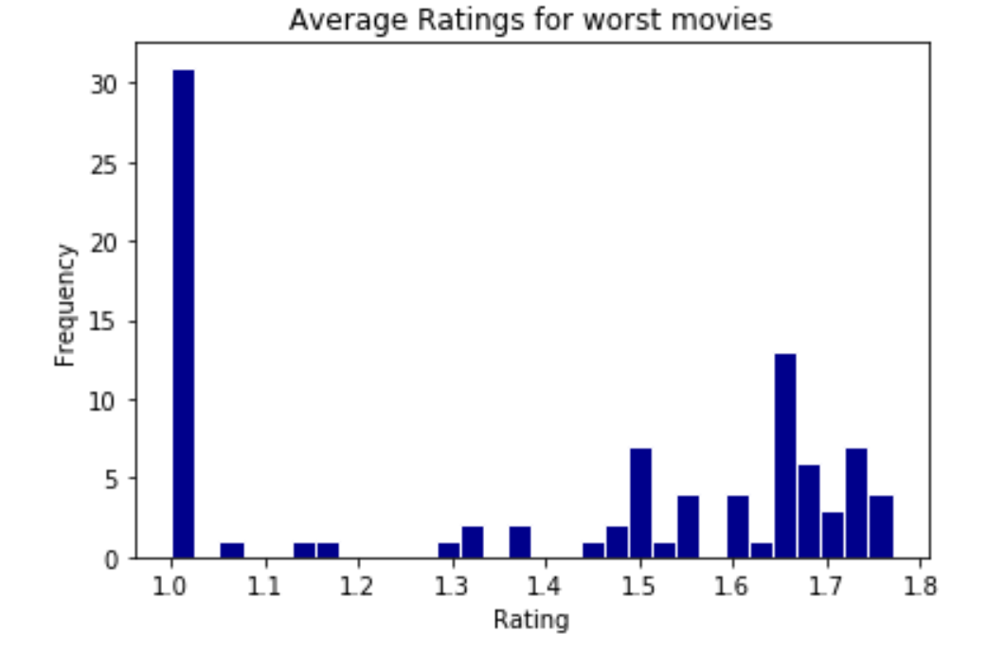
Conjectures 2: Average Ratings for Best versus Worst Movies
Average rating observed to increase with increasing age over 20.
The best movies are more frequently rated closer to 4 than 5.
Movies receiving the worst possible average rating are more frequent in our data set than movies receiving the best possible average rating.

Slide 11
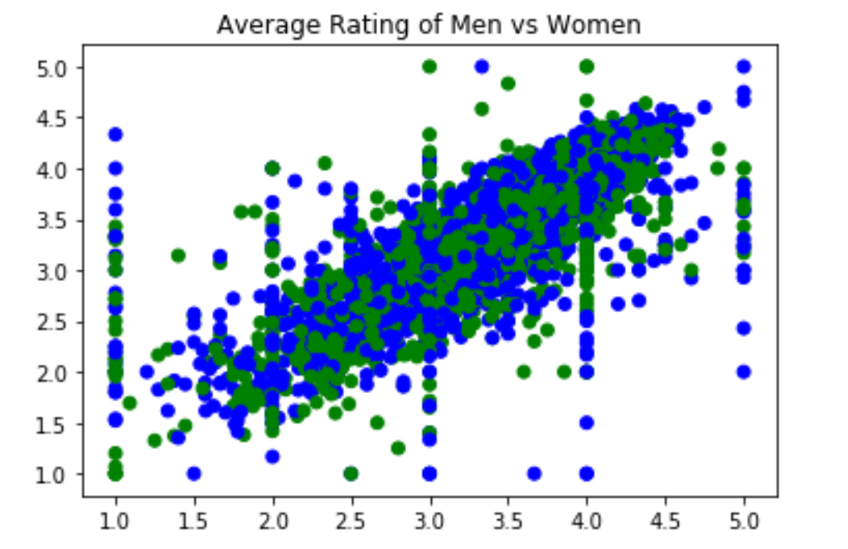
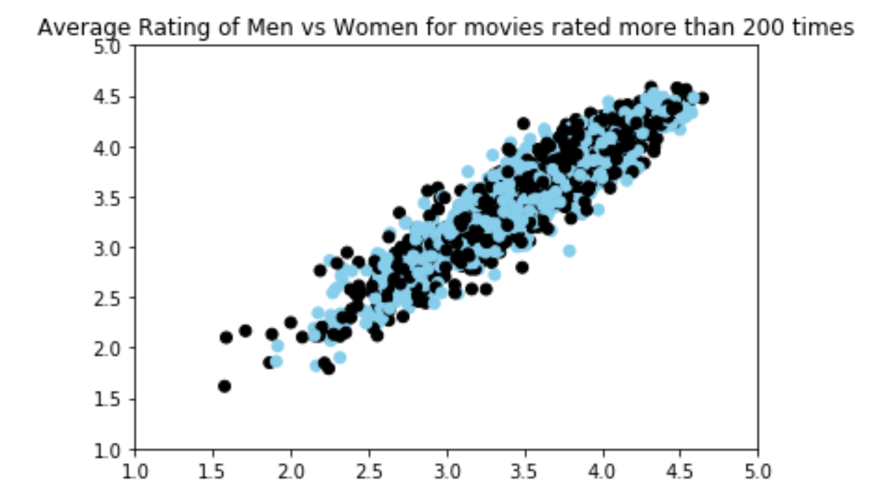
Average Ratings by Men and Women and Men and Women by High and Low Correlation Occupations

Slide 12
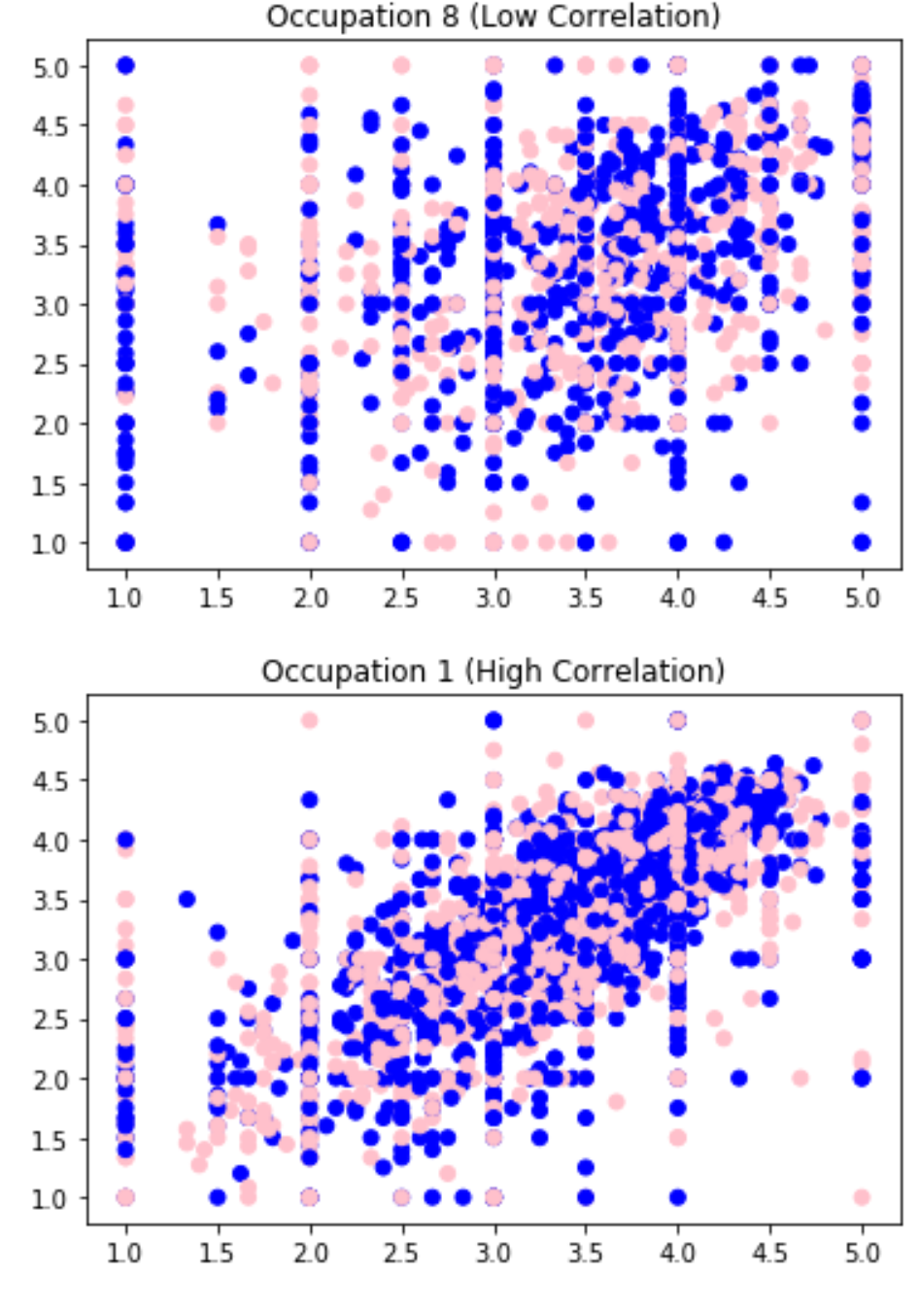
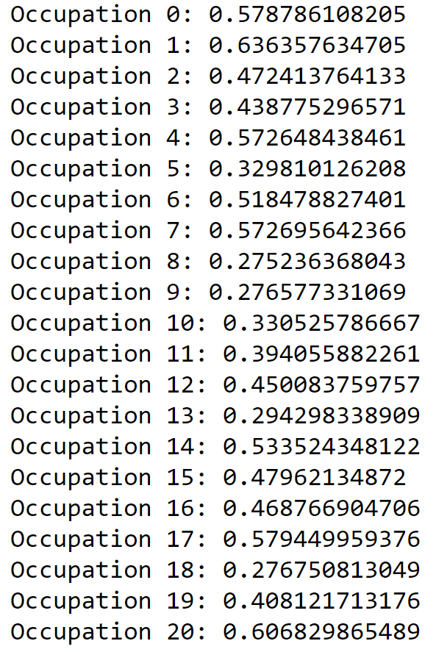
Conjectures 3: Correlation Coefficient between Men’s and Women’s Average Movie Ratings Based on Occupation

Slide 13
Business Case
What can we learn from the most poorly rated movies?

Slide 14
279 Movies for which production budget and profit/loss information were studied to examine profitability
REF: https://stephenfollows.com/hollywood-movies-make-a-profit/
Movie Profitability
51% of movies were profitable
49% of movies resulted in a loss
Movie Losses
Approximately half of money lost on non-profitable movies was lost on the lowest performing 6%.

Slide 15
Movie Ratings versus Movie Profitability
(http://www.nytimes.com/2012/07/01/magazine/how-does-the-film-industry-actually-make-money.html)
Production Costs
Budget
Marketing
Distribution
Talent
Financing
Audience Reviews?
Artistic merit
Versus
Audience appeal
Revenue Sources
Ticket sales
Home video
Television
Streaming
Hotels
Airlines
Merchandise
Soundtrack
Poorly rated movies may still be profitable
movies that are part of successful series
popular book adaptations
movies featuring specific actors or actresses with large fan bases
Acknowledging such exceptions, we hypothesized that the lowest rated movies will not have lasting appeal and be less profitable on average over time.

Slide 16
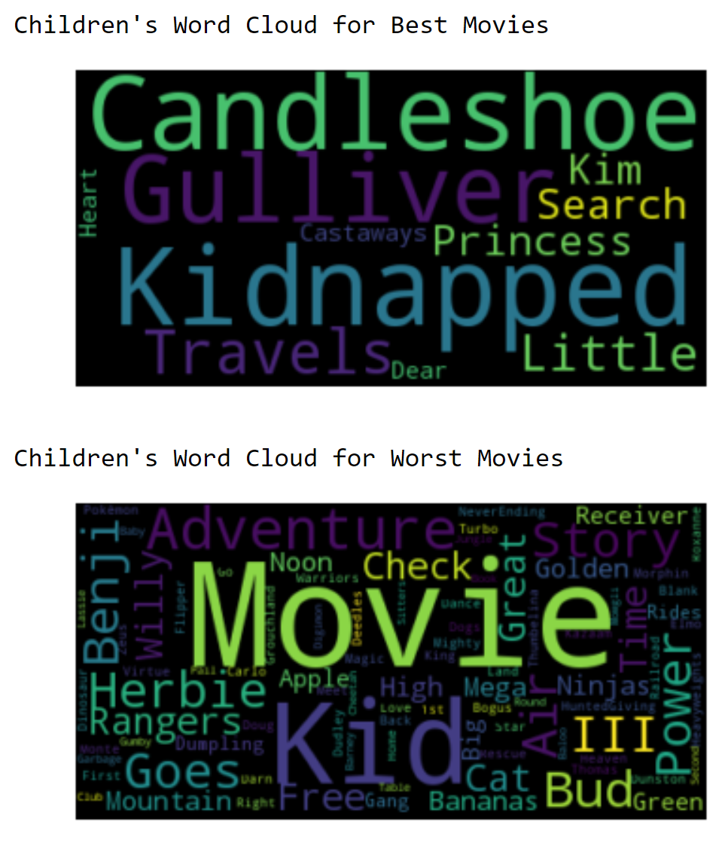
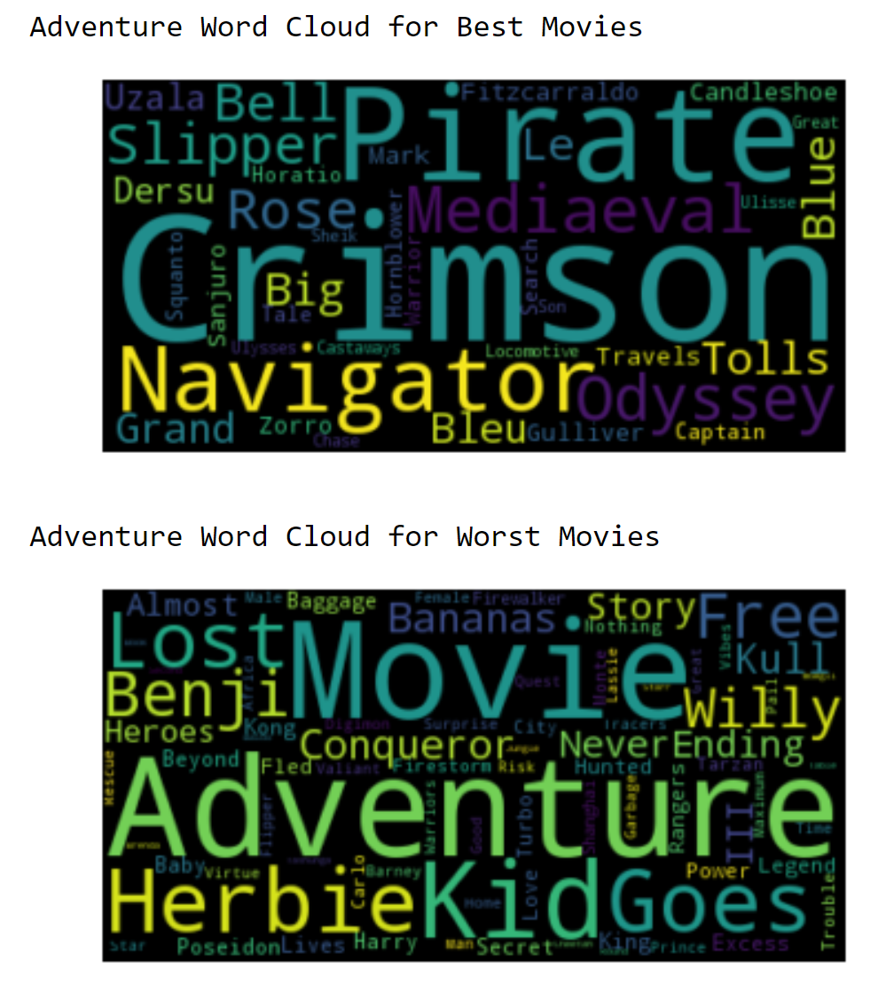
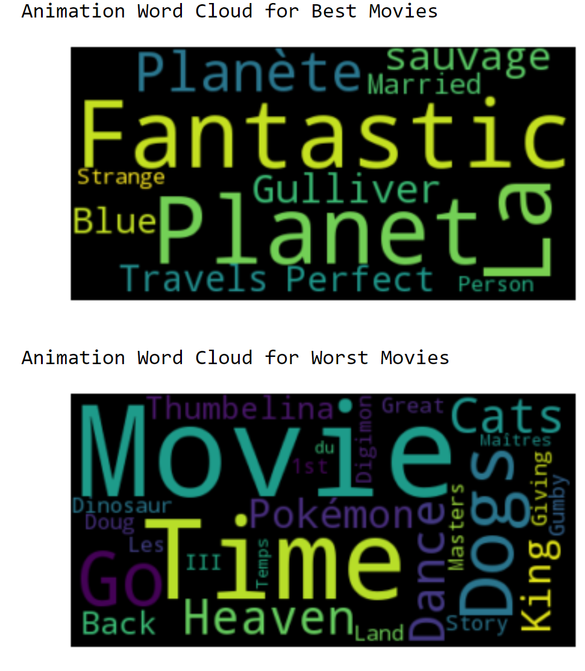
Word Cloud - Most Popular versus Most Poorly Rated Movies
Children’s
Adventure
Animation

Slide 17
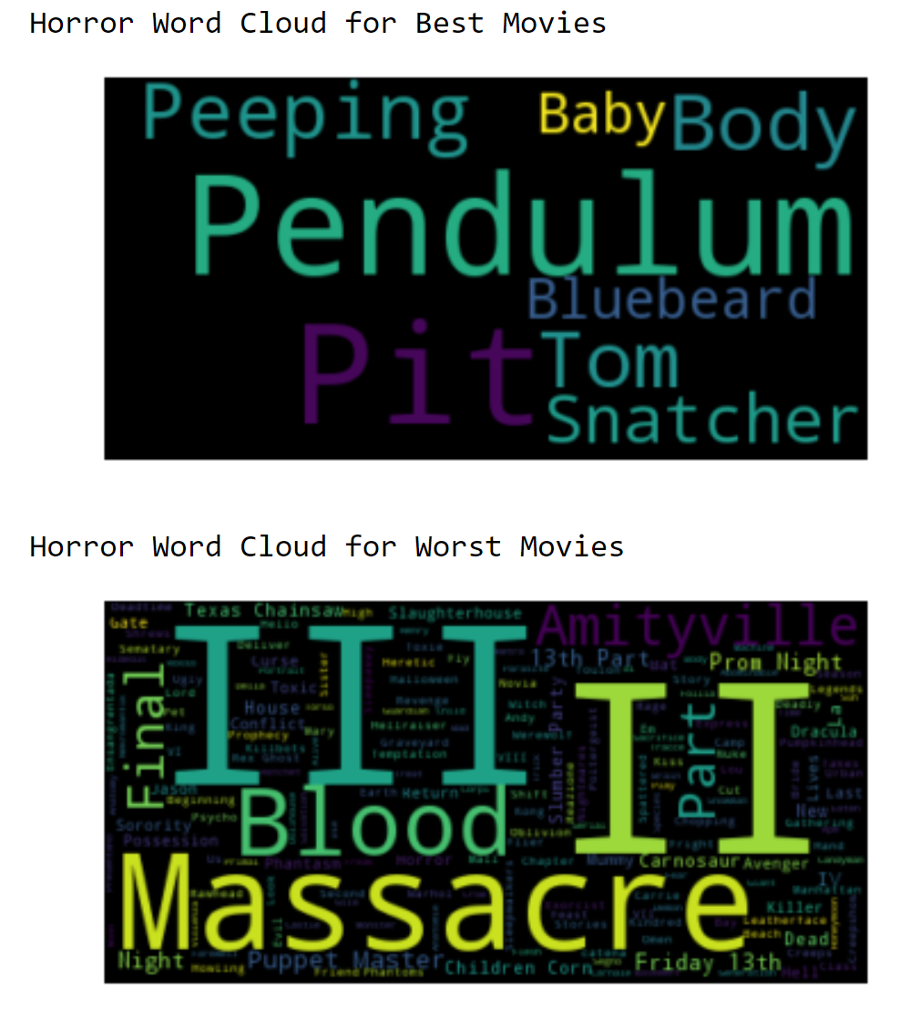
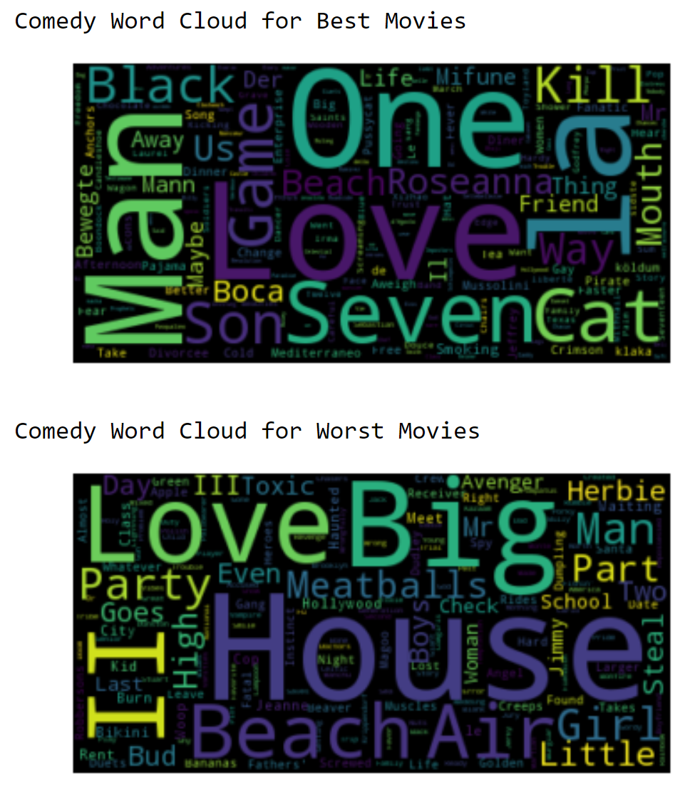
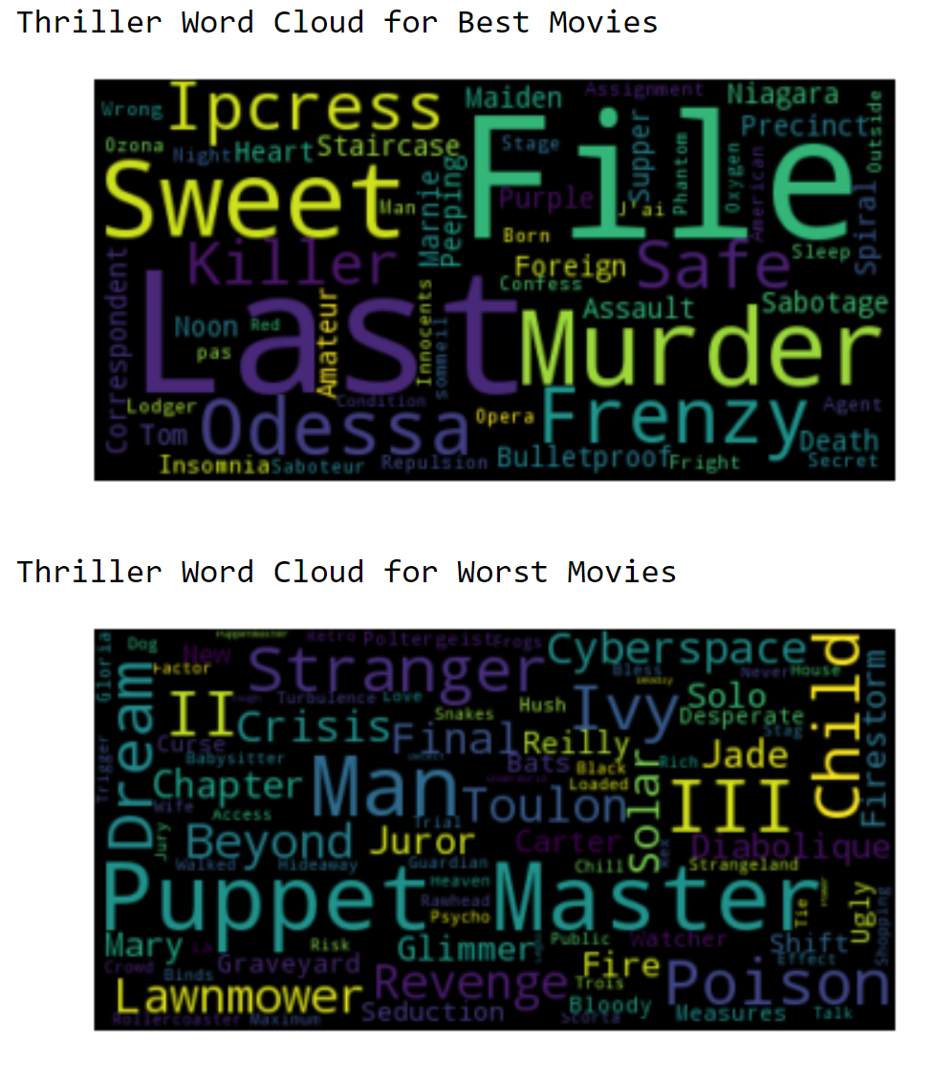
Most Popular (TOP) versus Most Poorly Rated Movies (BOTTOM)
Horror
Comedy
Thriller

Slide 18
Business Insights
Don’t overthink it.
Don’t spend too much money marketing a sequel.
Further analysis is needed to explore relationships between ratings and profitability by genre.

Slide 19
Thanks!
ANY QUESTIONS?

Slide 20
CREDITS
Special thanks to all the people who made and released these awesome resources for free:
Presentation template by SlidesCarnival
Photographs by Unsplash

